Slide 1
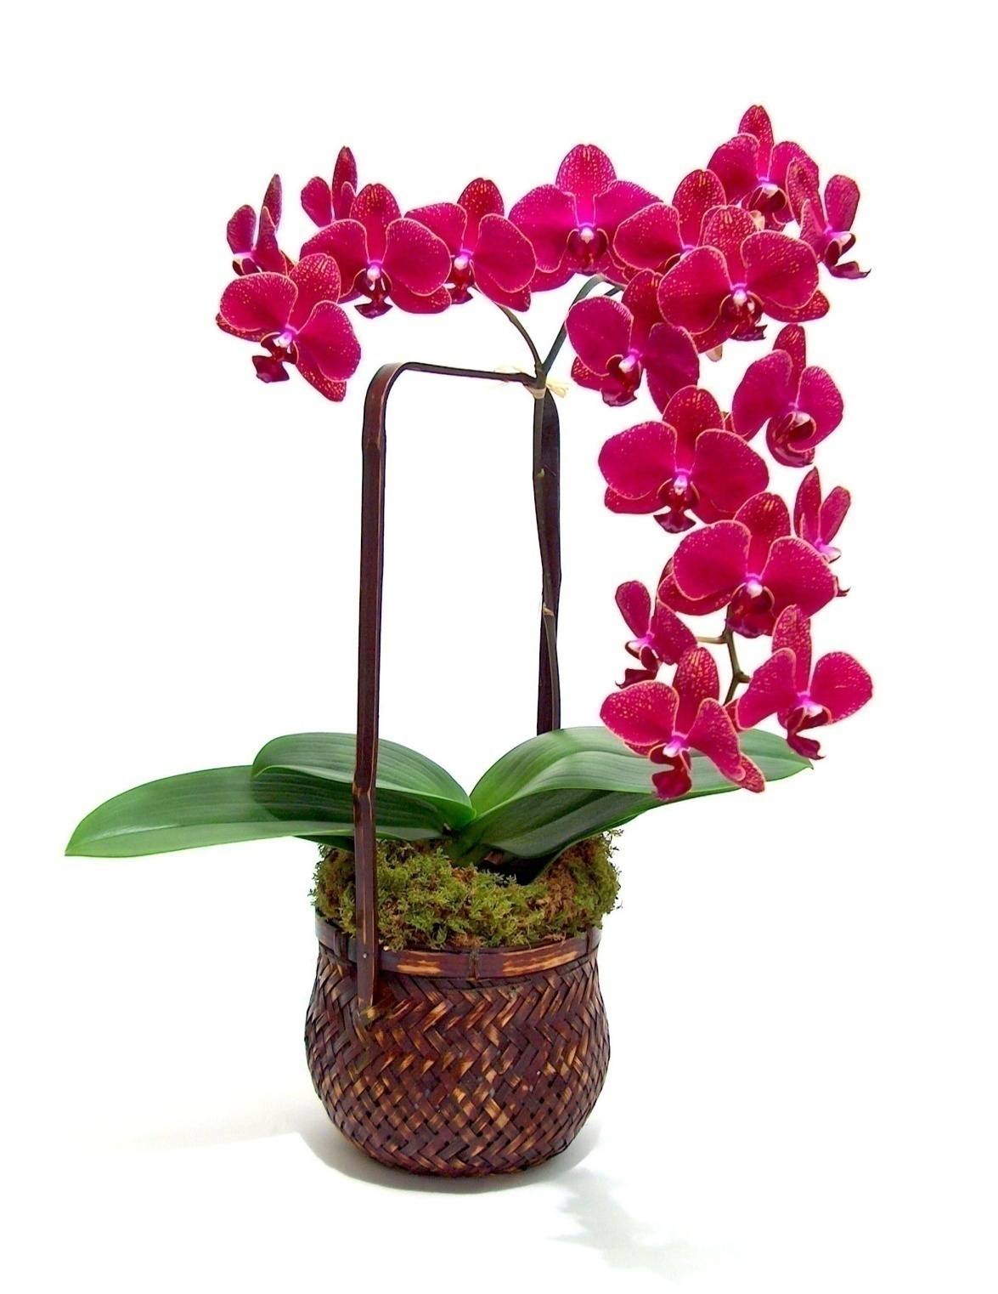
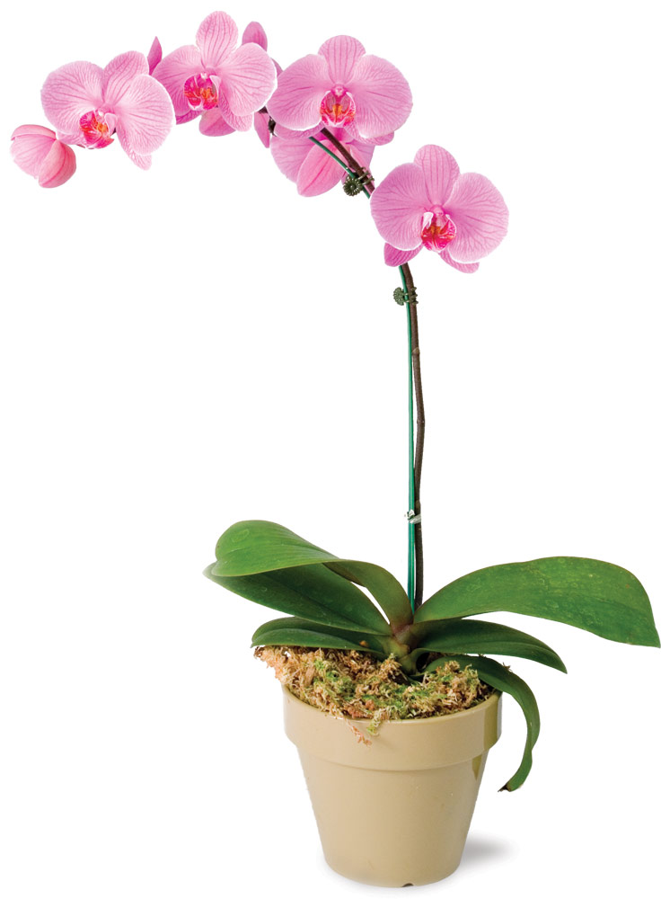
Orchid

Slide 2
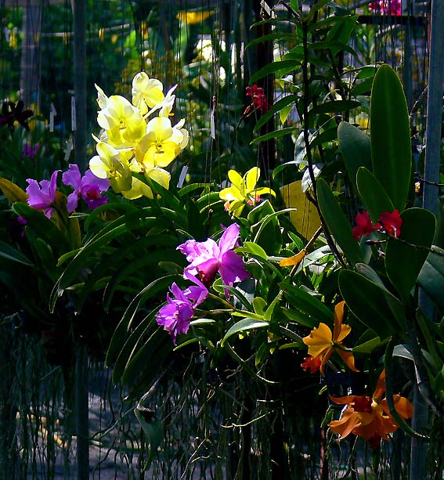
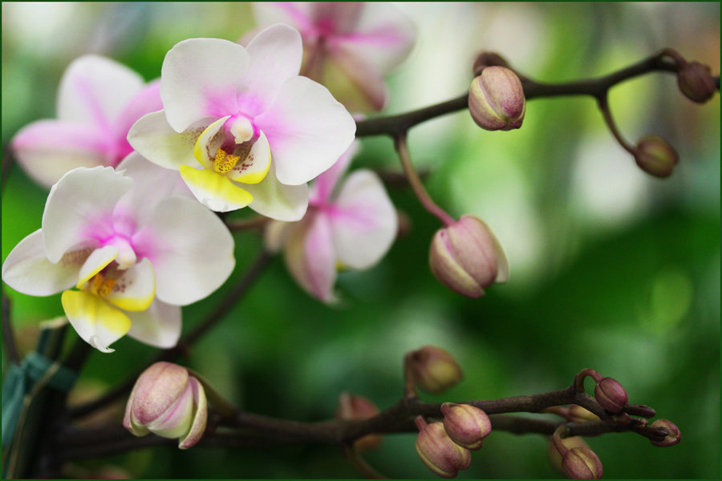
Introduction
Orchids are the largest and most diverse group among the angiosperms. They are cultivated for beautiful flowers. They are widely known for their economic importance but less for their medicinal value.

Slide 3
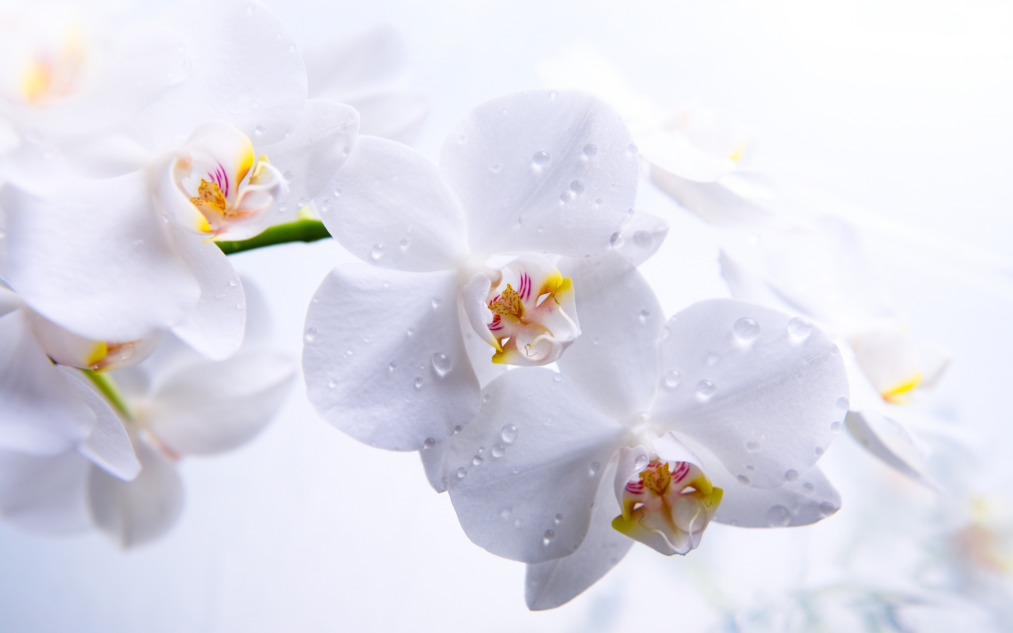
Meanings of orchids
Orchids in general signify wealth, strength, love as well as a rare and delicate beauty.
A symbol of virility
In Ancient Greece, orchids signify virility and were used to determine the gender of an unborn child. It was strongly believed by Greek women that if the father of the unborn child ate large, new orchid tubers, the baby will be a boy. On the other hand, should the mother of the unborn child were to eat small orchid tubers, the baby would be a girl.

Slide 4

Distribution of Orchids
The following list gives a rough overview of Orchids distribution:
Oceania: 50 to 70 genus
North America: 20 to 26 genus
tropical America: 212 to 250 genus
tropical Asia: 260 to 300 genus
tropical Africa: 230 to 270 genus
Europe and temperate Asia: 40 to 60 genus

Slide 5

Some Characteristics of Orchids
Orchids can grow in almost all types of environments.
Orchids usually do not grow in soil. Their roots attach to trees or rocks where they capture moisture and nutrients.
Tropical orchids usually grow high in the tree in order to get good air circulation and plenty of light & they prefer a 12-hour day.
Monopodial orchids have a single, upright stem, with and opposite leaf allegation. The flower stem appears from the base of the uppermost leaves.
Sympodial orchids grow horizontally, sending out new shoots from the old rhizome.

Slide 6
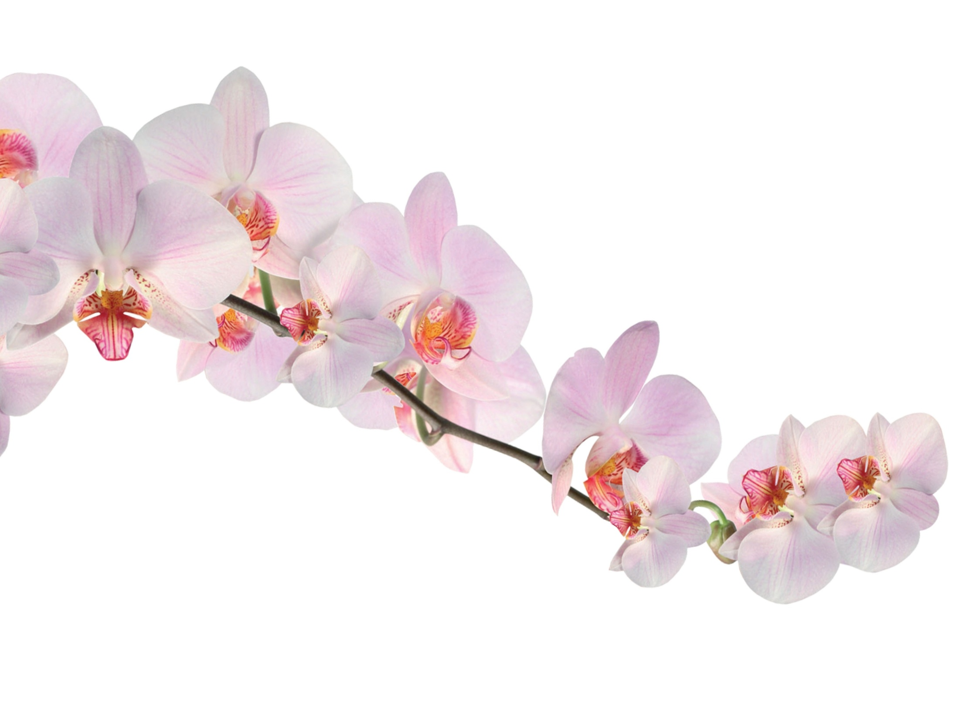
How to grow orchid
Orchids should be potted in small container/spots according to the size of the plants. As a thumb rule, orchids should be under potted to get more flowers. Any kind of pot/container which can hold medium and provide aeration is suitable. Most of the people prefer plastic pots which retain moisture longer than mud pots. Orchids can be grown in teak-wood baskets. Orchid plants should not be disturbed frequently and repotting done only when absolutely necessary.

Slide 7
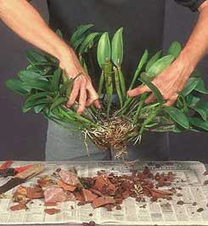
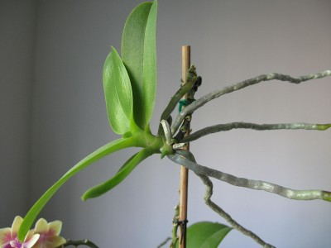
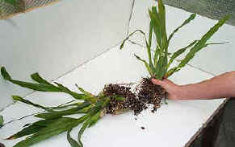
Propagation of Orchid
Cuttings: Orchids like Aerides, Arachnis, Epidendrum, Renanthera, Phalaenopsis, Vanda and Dendrobium can be propagated by cutting. Orchids cutting are usually more bigger and should posseses one or more roots. Cutting are usually potted in propagation beds or directly in pots after treating the cut ends with fungicides to prevent rotting.

Slide 8
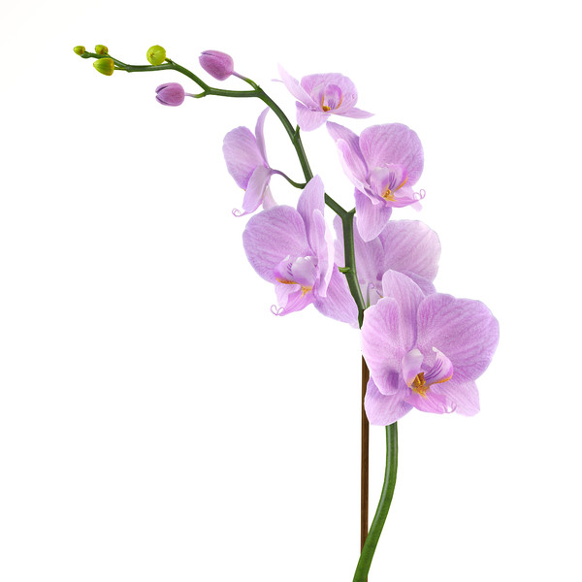
Cont.
Off-shoots : In some monopodial orchids like Ascocenda and Phalaenopsis, off-shoots emerge frequently on the main stem. This usually happens when the apex has lost its effectiveness in suppressing auxiliary buds.
Aerial Shoots: Most of the dendrobiums produce aerial shoots or bulbs on old back bulbs devoid of leaves. They usually arise on the upper part of the back bulbs and grow out slowly. These aerial shoots take 90-120 days to develop roots. At this stage, they are detached along with the portion of back bulb and potted as independent plant.

Slide 9
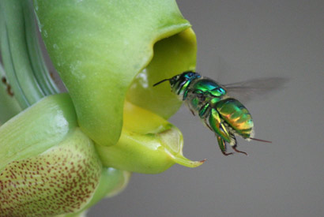
Pollination in Orchids
Orchids flower produce pollinia. When the pollinator enters into the flower, it touches a viscidium, which promptly sticks to its body, generally on the head or abdomen. While leaving the flower, it pulls the pollinium out of the anther, as it is connected to the viscidium by the stipe. The stipe then bends and the pollinium is moved forwards and downwards. When the pollinator enters another flower of the same species, the pollinium has taken such position that it will stick to the stigma of the second flower, just below the rostellum, pollinating it. Pollination also happened by using pencil, small paintbrush.

Slide 10
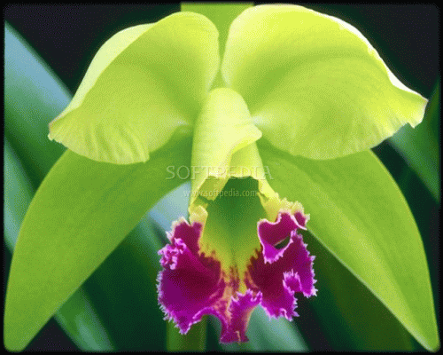
Disease of Orchid
Leaf spot & Leaf blight.
Collar blotch & Collar rot.
Orchid wilt
Cymbidium mosaic virus
As control measures all infected plants should be isolated to prevent spreading of the disease.

Slide 11
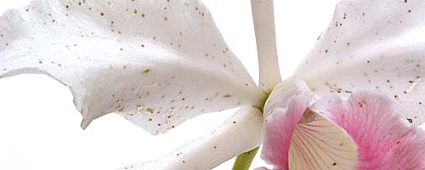
Pest of Orchid
The most commonly reported insects pests on orchids are thrips, aphids, spider mite, soft scale, mealy bugs, orchid weevil, snail and slugs. These insects pests harm the plants in many ways. They feed on tender young shoot, suck the sap and damage the young bud and shoots and also act as the carrier of different diseases.
Fortunately all these can be controlled by effective insecticides like Parathion, Malathion, has proved to be very effective in killing slugs and snails.

Slide 12
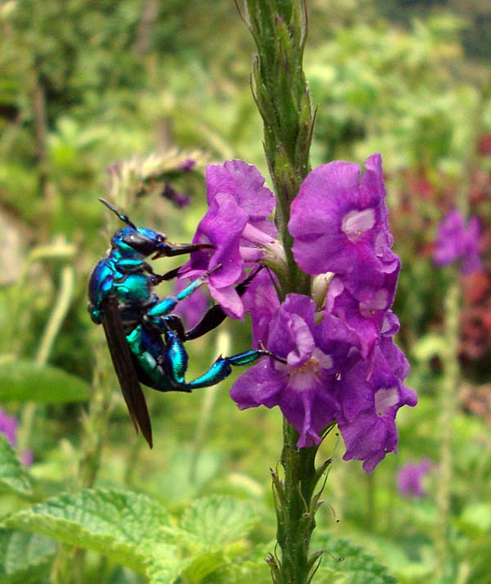
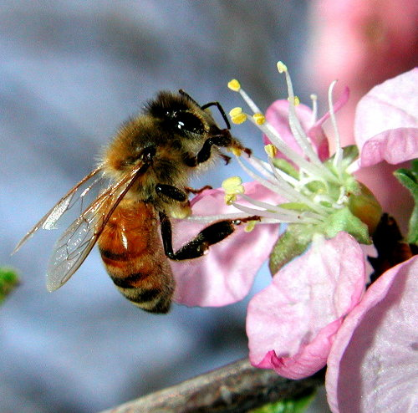
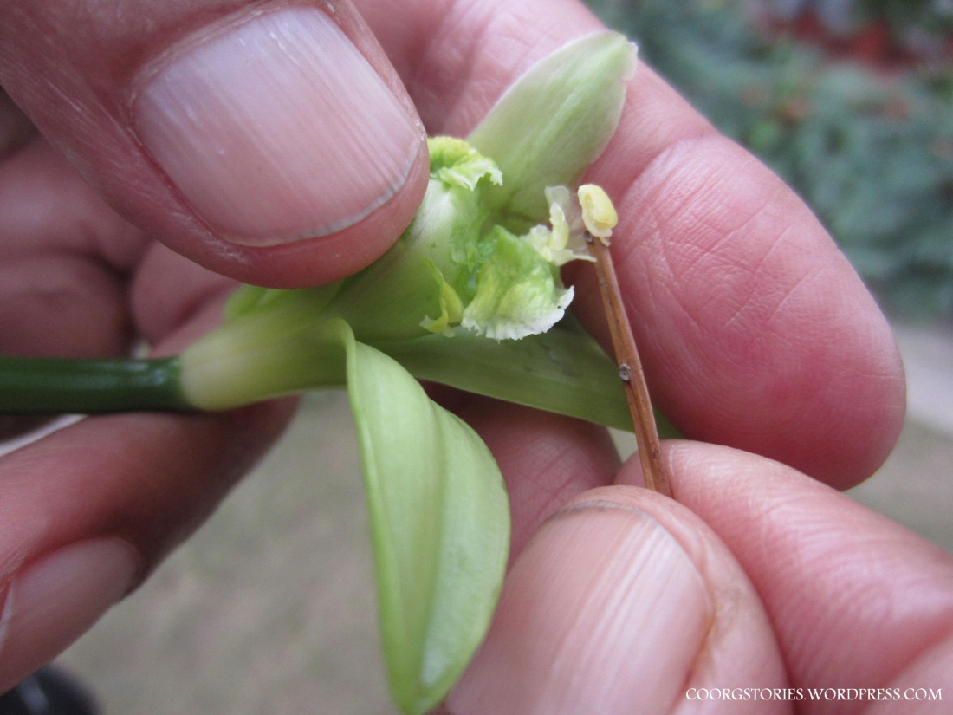
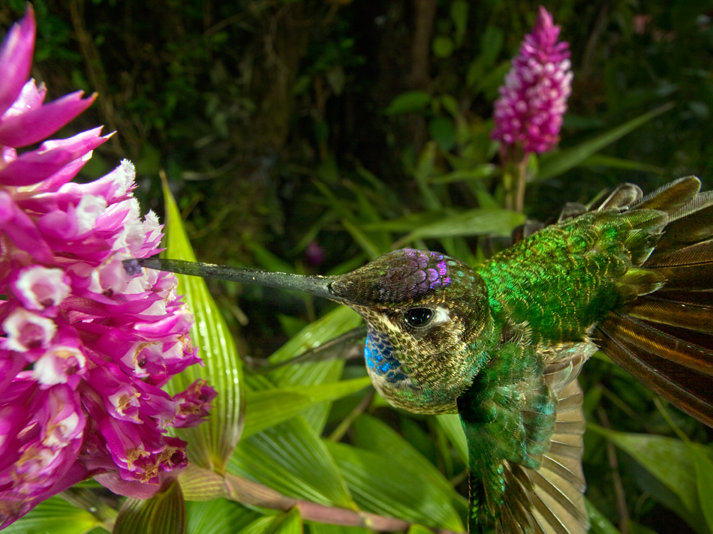

Slide 13

Commonly Cultivated Orchid Plants
Many orchid plant species have become tremendously popular over the years for two main reasons. These are their beautiful showy blooms and the ease of care required.
Cattleyas
Phalaenopsis
Paphiopedilums
Cymbidiums
Dendrobiums
Oncidiums
Vandas

Slide 14
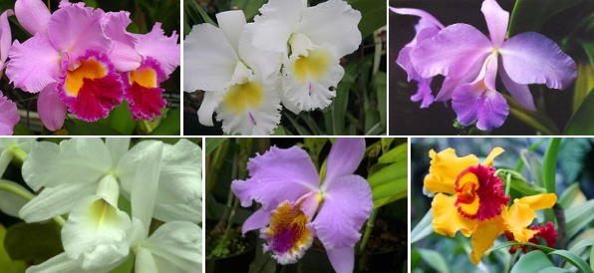
Cattleyas
Cattleyas are some of the showiest and most rewarding orchids for the home. They range in color from the classic orchid lavender to white, red, yellow, orange, green, and blue. Many Cattleyas are very fragrant. They prefer intermediate home temperatures. If you want to get those big showy blooms to come forth from your plant, you must provide medium-bright light.

Slide 15
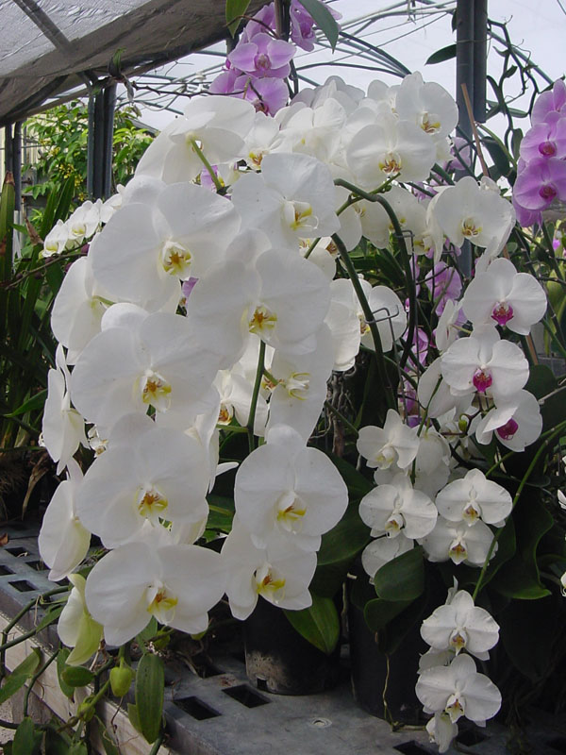
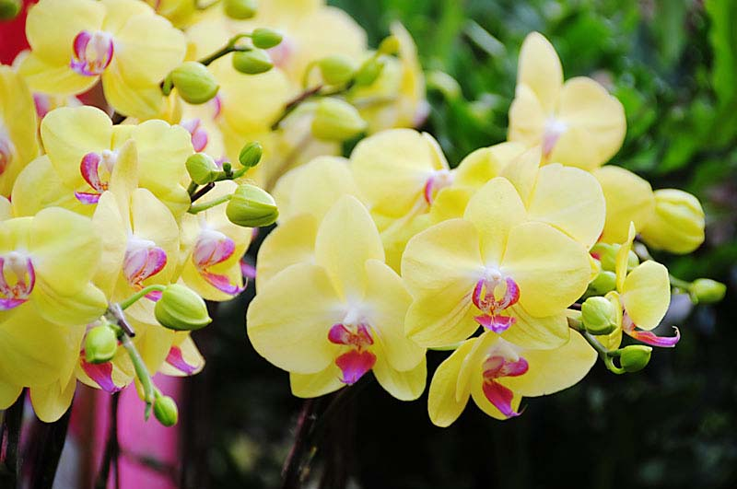
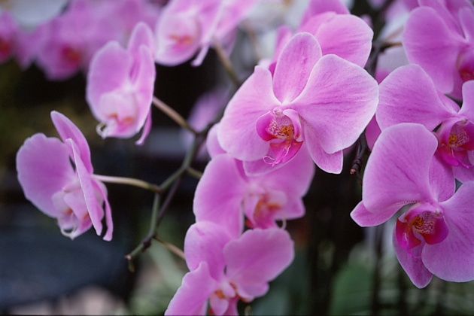
Phalaenopsis
Phalaenopsis orchids are possibly the best beginner’s plant. Phalaenopsis are among the easiest orchids to grow at home. They prefer lower light and warm home temperatures where winter nights do not drop below 60F. Phalaenopsis send up long arching sprays of flowers up to 6 inches across, in colors from basic white to pink, yellow, peach, red and green. The flowers resemble wide-winged moths in flight.

Slide 16
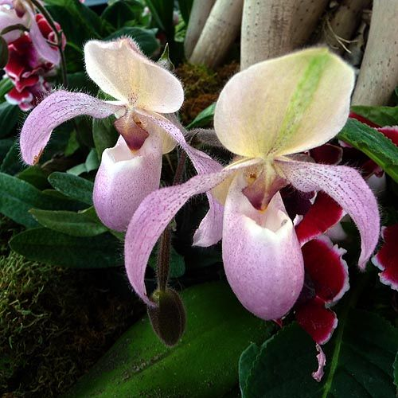
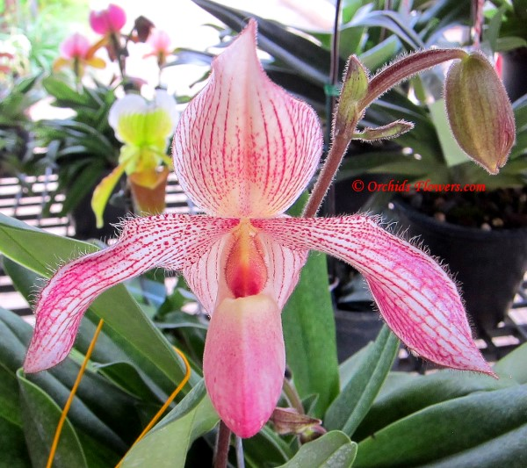
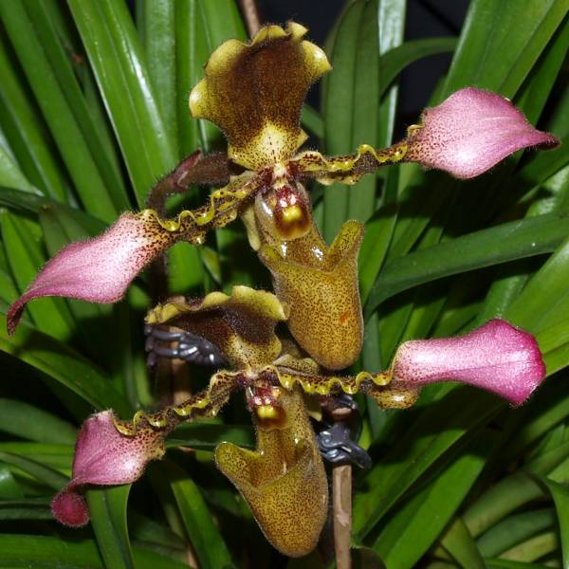
Paphiopedilums
Paphiopedilums are excellent orchid plants to grow side by side with the Phalaenopsis plants. This orchid plant requires low light and warm/intermediate temperature preference. Paphs are unique in appearace. The sophisticated, waxy pouch and striking top sepal, combined with a variety of spots, stripes, hairs, twists, and different color flowers, make these a winner’s choice.

Slide 17
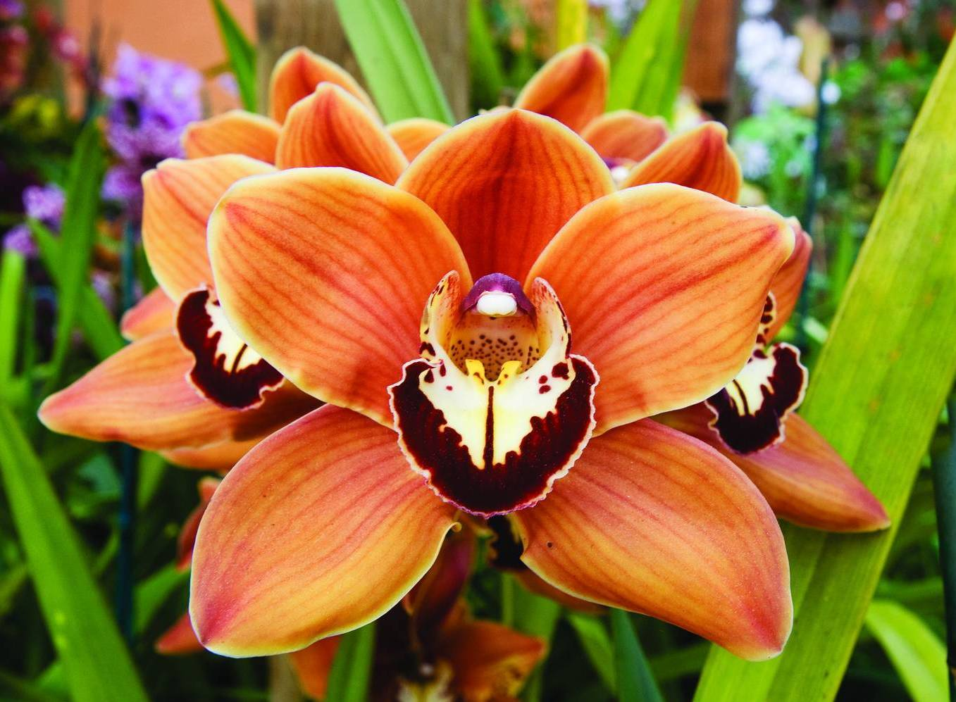
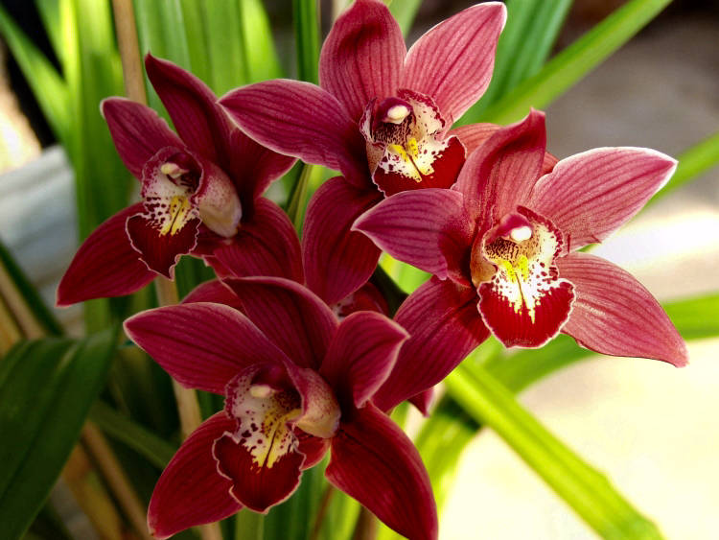
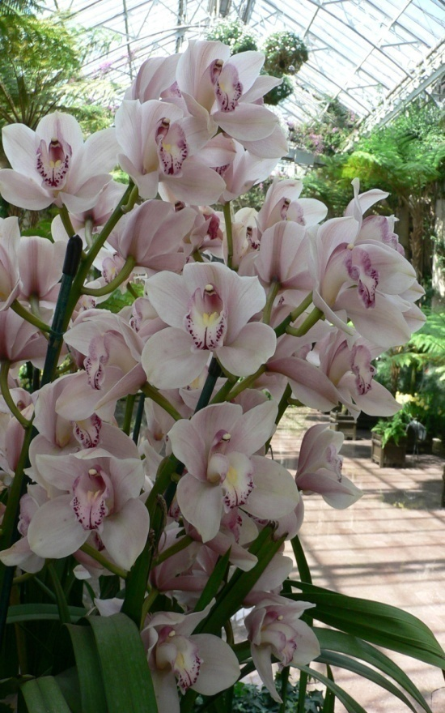
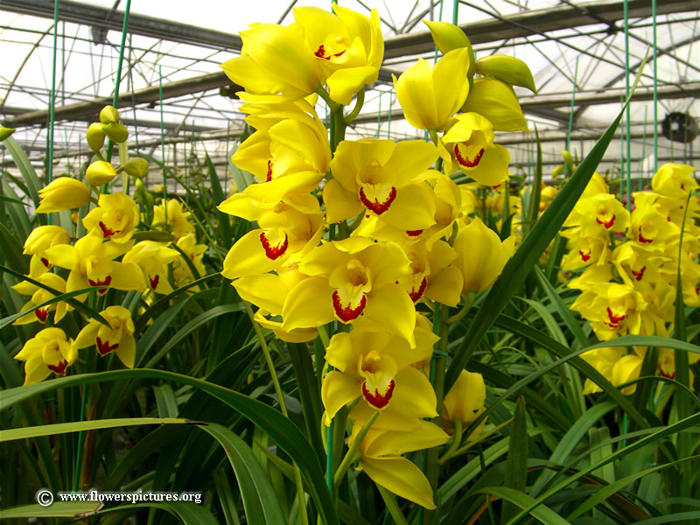
Cymbidiums
Cymbidiums are the oldest cultivated orchid plants. These plants have become the orchid mainstay in the cut-flower industry. Their spikes of white, green, yellow, rose and red flowers can last up to two months or more in water. The blooms on the plant can stay even longer. These big plants are very easy to grow. If they are given high light and very cool temperatures they will give any orchid hobbyist true pleasure.

Slide 18
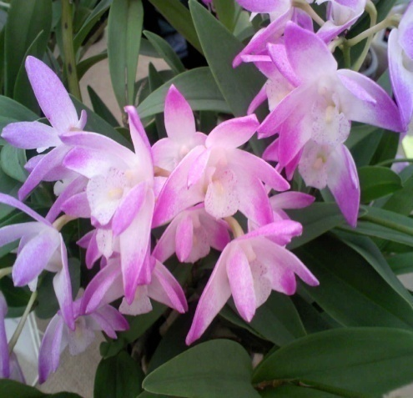
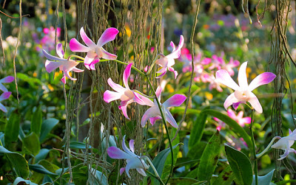
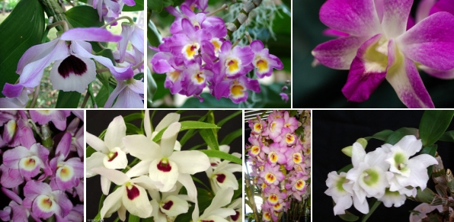
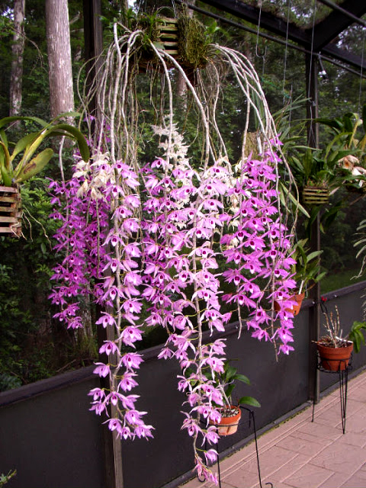
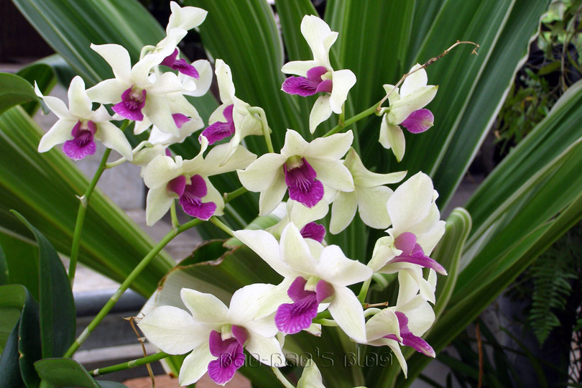
Dendrobiums
Dendrobiums span a large range of types, sizes, colors, shapes and cultural requirements. Dendrobiums have tall canes and regardless of type, want bright light, small pots, well-drained mixes, good air movement and humidity between 50 and 70 percent. Providing these elements, you will have profuse-blooming plants.

Slide 19
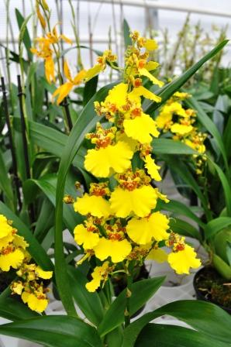
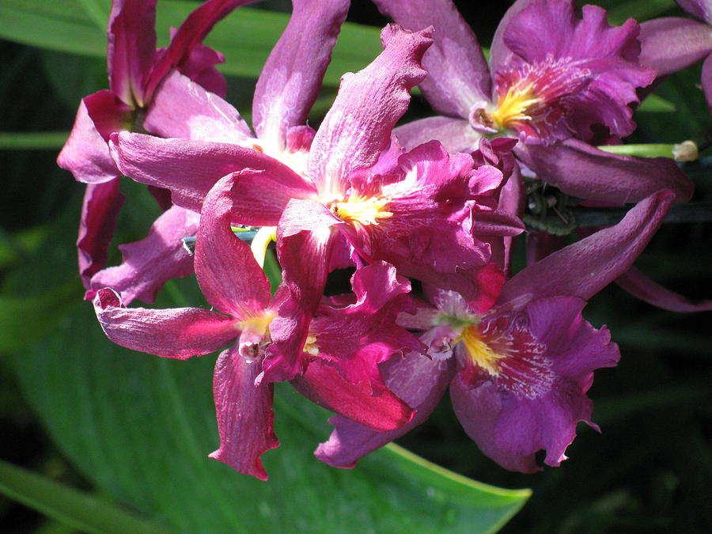
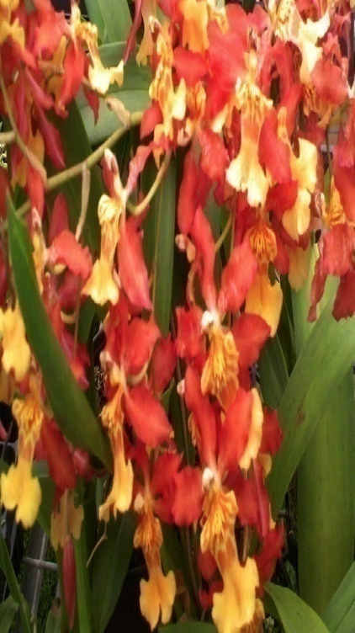
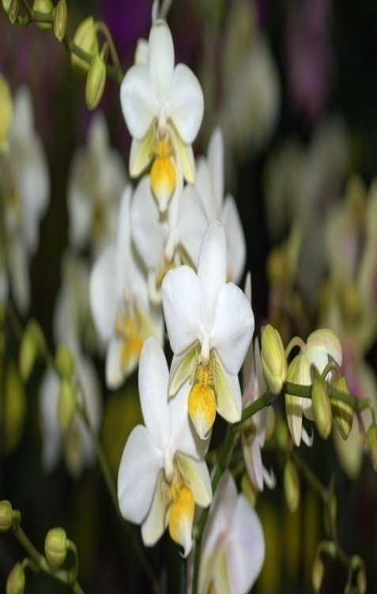
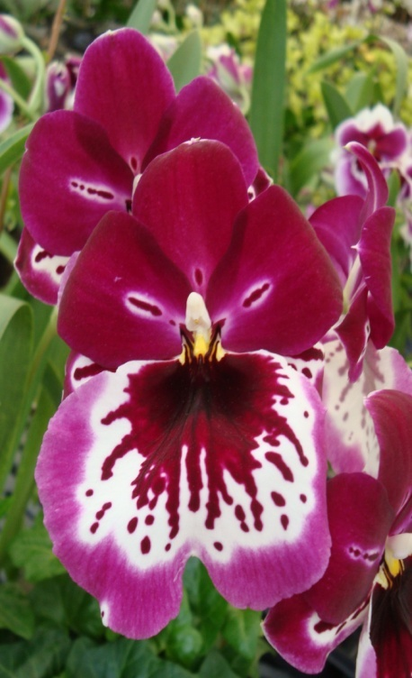
Oncidium
The Oncidium orchid plant produces dancing sprays of brilliant yellow blooms. They like lots of light for best bloom and a bright southern windowsill often works well. Most prefer intermediate temperatures. The Oncidiums grow best in clay pots fill with a coarse, well-drained mix, or mounted on clay or bark slabs. They require good air movement along with humidity above 50 %. Oncidiums prefer lots of water with a drying out between each watering. They are truly a delight to grow.

Slide 20
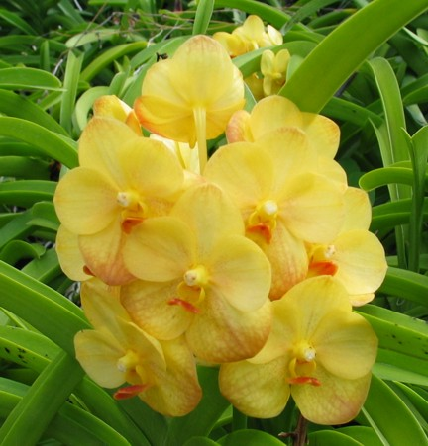
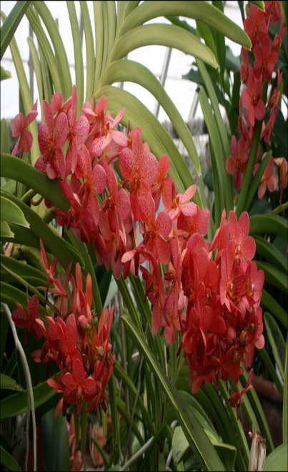
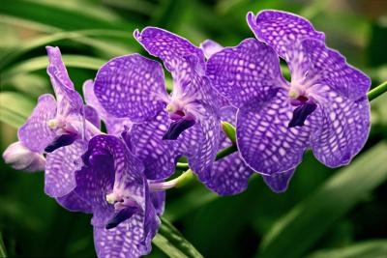
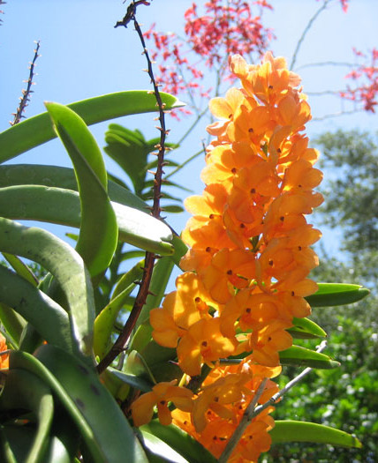
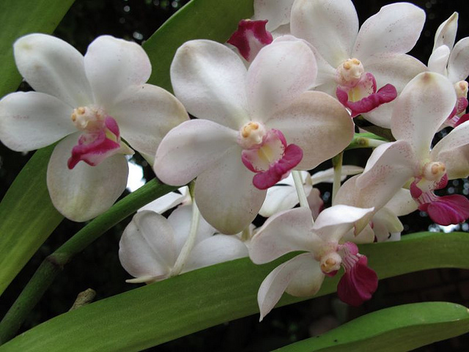
Vandas
The Vandas are gloriously brilliant plants, producing colorful round flowers, including spectacular blue, that can reach 5 inches wide on long profuse spikes. Most orchids bloom in the winter time, but Vandas dominate the summer months. These plants love high-light. Vandas, with lots of aerial roots, grow exceptionally well undisturbed in baskets. Vanda plants, not bred with any other species of orchid, can reach heights of up to 10 feet high. Bright, hot southern window exposures are perfect, and a spot where the plants can be watered and fertilized freely and abundantly is ideal.

Slide 21
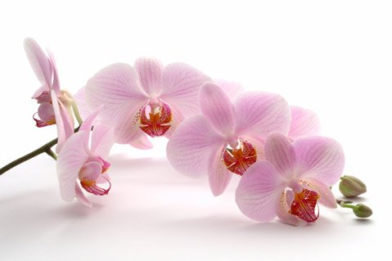
Significance of Orchids
Orchids are graceful and elegant flowers with a simple and rare beauty.
It is an exotic flower that captivates the attention of the beholder, with an mysterious magnetism.
These beautiful flowers have proven to have the largest variations with 20,000 to 30,000 species of orchids growing in every continent except the Antarctica.
With the fact that orchids are adaptable and well liked.
It is no surprise to note that orchids are the most highly prized of ornamental plants and they are also the most popular houseplants.

Slide 22
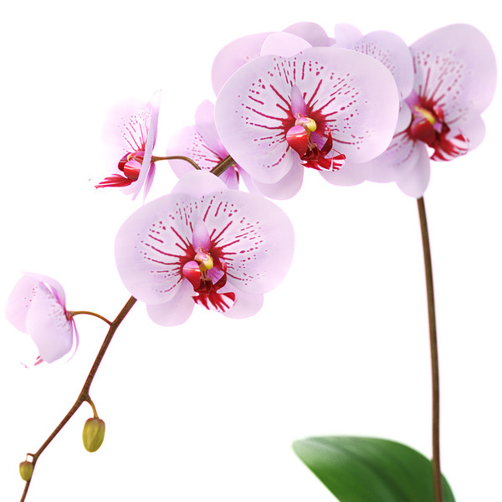
Economical Importance of Orchids
Orchid is a modern profitable trade involves hundreds of thousands of dollars every year around the world.
Some orchids are commercialized not for their beauty, but because of their use in human food industry.
The most important are some species of the Vanilla genus, largely used for flavoring cakes, ice cream, candy and sweets.
Salep is a cloudy fluid, rich in starch and sweet tasting, extracted from the tuberous roots of some orchid species, used as a treatment for diarrhea.
It has been used to prepare a tasty hot drink, and also to thicken ice cream.

Slide 23

Orchids for different occasions
Each type of orchid has a different personality and thus is suited to different occasions and uses.
Dendrobium orchids are most often used as cut flowers in tropical floral arrangements.
Cymbidium orchids were once considered as the official orchid for Mother's Day corsages.
Cattelya orchids were widely popular among brides & as part of their wedding celebration.
Phalaenopsis or Butterfly orchids is now a popular choice for modern floral arrangement due to its graceful simplicity and elegance.

Slide 24
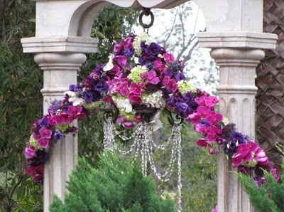
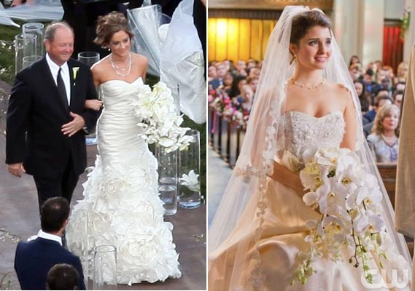
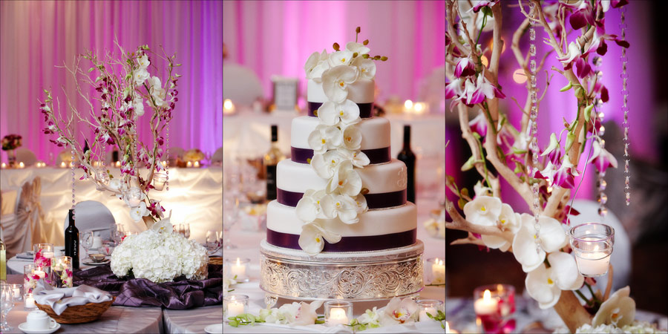

Slide 25
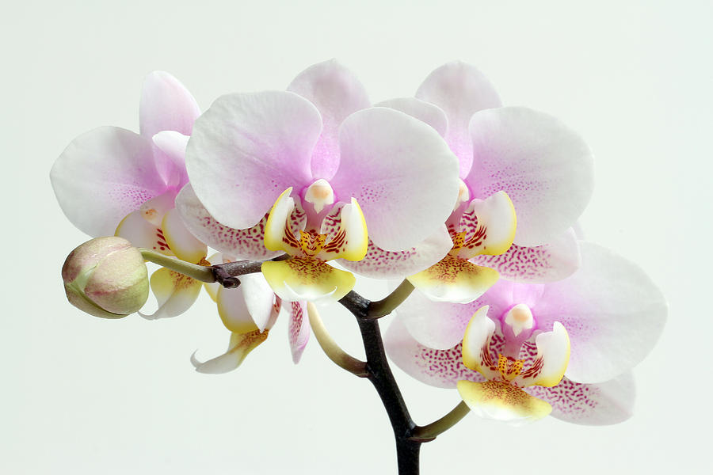
Storage Conditions
Can range from 0 to 12.5ºC depending on cultivar. Many cultivars are not chill sensitive and therefore can be stored as other cut flowers at 0-1ºC. If feasible, leaving flowers on the plants at room temperature is a good storage procedure. Be careful not to remove or knock off the pollinia (anthers) as this causes an immediate surge in ethylene production, which, in turn, causes premature death.

Slide 26
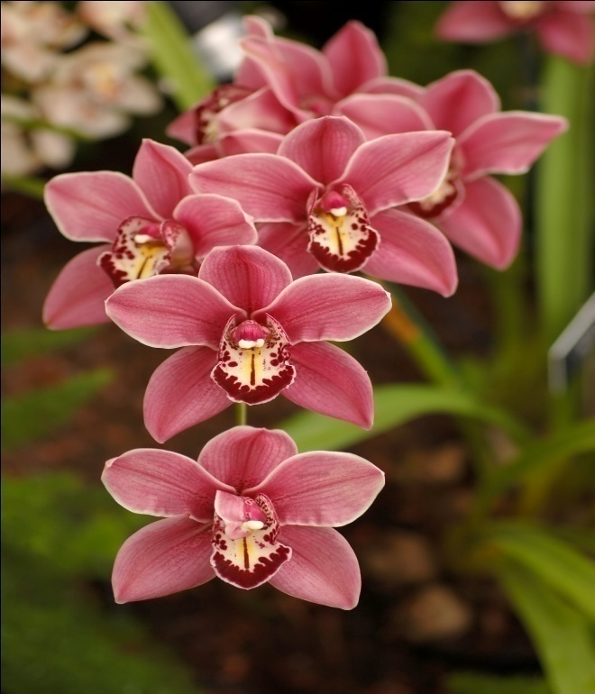




Photo Gallery

Slide 27






Slide 28

Conclusion
Orchids are a charismatic group and have been called the "pandas of the plant world". They are a prominent focus of plant conservation. Many nature reserves exist because of the orchids that occur there.

Slide 29

Thank You

Slide 30

ANY QUESTION

